Slide 1
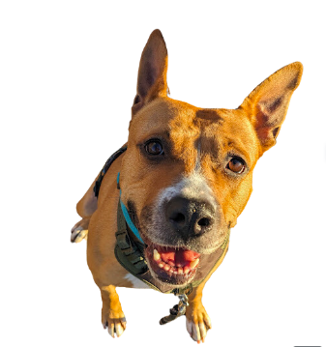
Welfare-Focused Training Partnerships
^^^Real, adorable, IACS alum

Slide 2
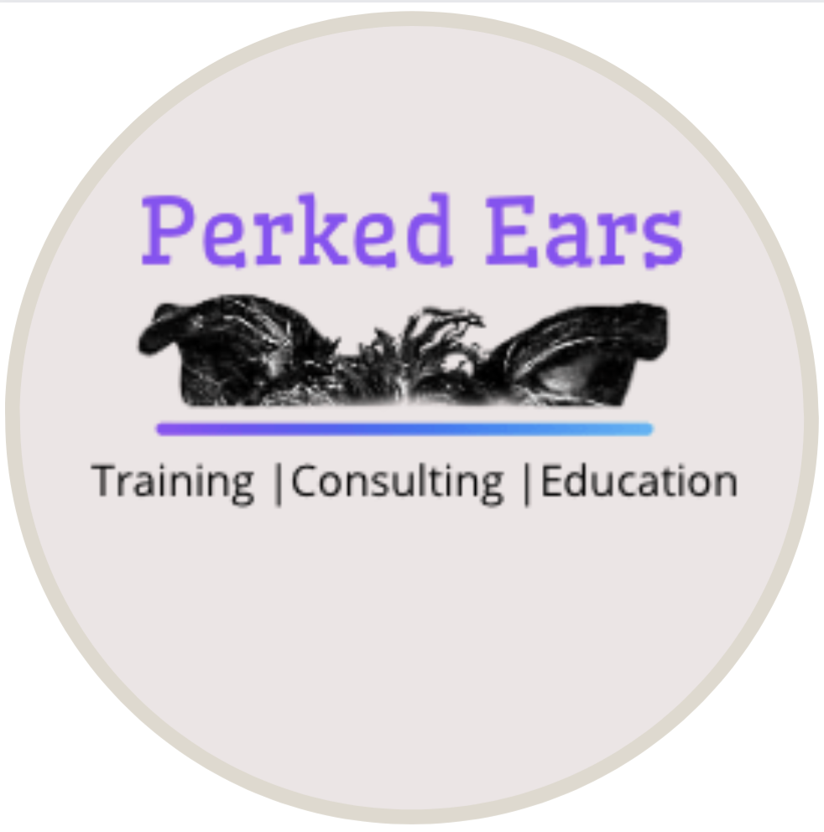
Sky’s the Limit Animal Training and Behavior
Perked Ears Behavior Consulting
Allie Kirby, CTC, CSAP-BC, FFCP- Trainer
Kristen Board, MA, CTC, CBCC-KA, PCBC-A

Slide 3
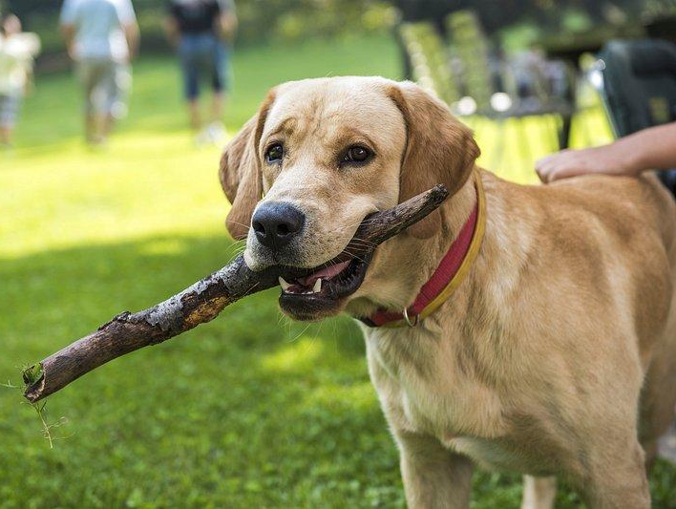
Welfare-Focused Training
Positive
reinforcement, force-free methods
The dog comes first: change behavior, not the dog
Meet needs and allow expression of normal behaviors
Increase human welfare: stronger bonds and more empathy
Notes:
Positive-reinforcement, force-free methods
Focus on what we want dogs TO DO and reinforce it
Replace unwanted behaviors
The dog comes first
Health, safety, and mental wellbeing
Focus on changing behaviors, not the dog
Meeting dogs’ needs
Allows expression of normal dog behaviors
Dogs have preferences, thoughts, and emotions
Human welfare
Encourages a stronger bond with our dogs
Sets principle for empathy in human relationships

Slide 4
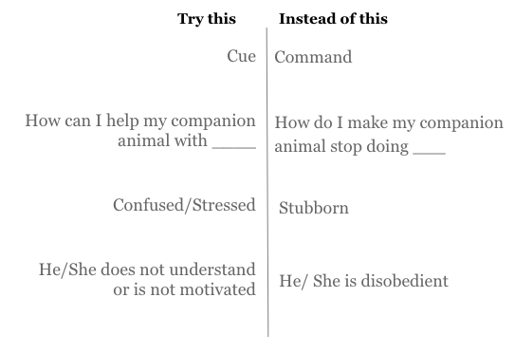
A Mindset Shift Creates a Healthier Bond

Slide 5
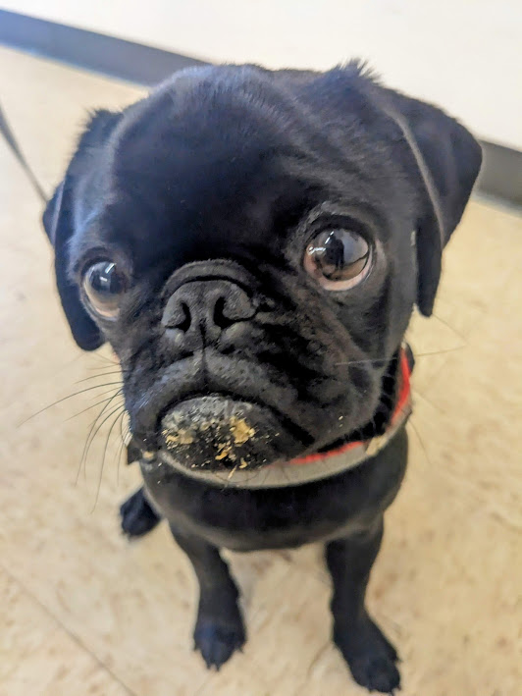
Why Choose This Method?
Increased welfare
Quicker responses to cues
Fewer behavior problems
More optimistic dogs
Positive impact on bonds
Better
Outcomes
Better
Outcomes
Fewer Side Effects
Aversive training increases fearful and aggressive behaviors
Works for All Dogs
Including fearful and aggressive behaviors
Notes:
Better outcomes
Increased welfare
Positive impact on the human-animal bond
Quicker, more consistent responses to cues
Fewer behavior problems
More optimistic dogs
Fewer side effects
Research shows increased fear & aggression in dogs trained with aversives
Works for all dogs, and all behaviors
Aggressive behaviors included

Slide 6
Finding a Welfare-Based Trainer
What happens if the dog gets it right?
What happens if the dog gets it wrong?
Welfare-based
Food, toys, play, access to environmental rewards
Try again, lose access to rewards, trainer considers change in plan
Correction-based (aversive)
Praise alone, stopping painful or uncomfortable corrections
Corrections, dog is forced to comply

Slide 7
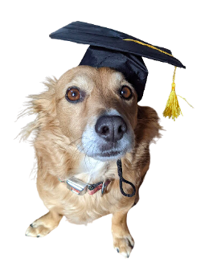
Education Matters!
Dog training is completely unregulated
Harmful methods are legal and commonly used
Notes:
Dog training is a completely unregulated industry
Anyone can call themselves a trainer!
Harmful methods are still legal and widely used today
Would you trust a dentist whose qualifications are “has teeth”?

Slide 8
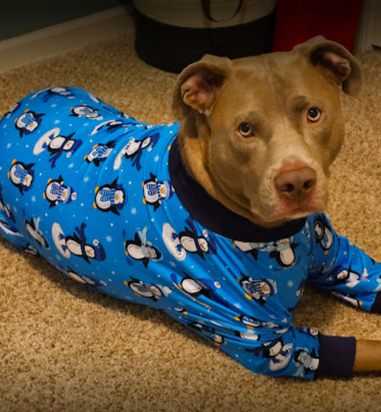
HOME Scholarships
$200 scholarship funded by Friends of Indy Animals
2 private sessions or 1 group class with a professional trainer
Available to all adopters and fosters
Partner trainers must exclusively use force-free methods
Notes:
$200 scholarship available to all adopters and fosters from IACS
Funded by Friends of Indy Animals
2 private training sessions with a professional trainer
Or participation in a group training class
Program exclusively partners with trainers who use force-free methods
~37% of adopters and fosters contacted show interest
~52% of requests are for basic manners-type behaviors
Leash walking, house training, chewing, basic cues, jumpy/mouthy behaviors
Additional ~10% request support for leash reactivity

Slide 9
HOME Scholarships by the Numbers
~37% of adopters and fosters contacted about the program are interested in training
~52% of requests are for manners-type behaviors
Leash Walking
House Training
Chewing
Basic Cues
Jumpy
Mouthy
Additional ~10% leash reactivity

Slide 10
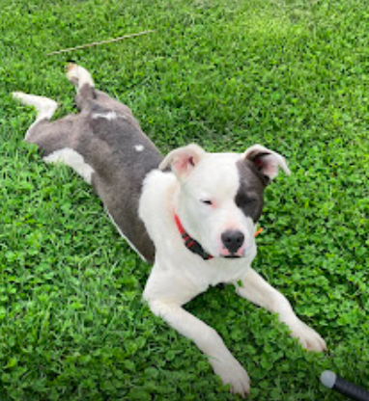
Success Story: Reed
Kristen’s help was a godsend with my foster dog Reed. I already had experience fostering for another shelter when I started volunteering for Indianapolis Animal Care Services (IACS) so I wasn’t too worried about taking on a behavior dog. Reed’s plight caught my attention because he had already nipped a volunteer hard enough to break their skin and was extremely at-risk….
I brought him home and quickly found out that he was more than I could handle - he was so quick and jumpy/mouthy that I couldn’t predict his behavior and get in front of it. Thankfully the IACS Behavior Team connected me with Kristen, who was able to quickly schedule a home visit before the situation became even more serious. I think her intervention saved Reed’s life. She was very intuitive about the root cause of behaviors, and had some amazing advice on how to work through Reed’s issues. Kristen’s advice helped me be able to handle him consistently and reinforce his training every step of the way. It was a long process, but Reed turned into a wonderful family dog who loved adventures, was well-behaved in public, had a great sense of humor, and liked to be in the middle of things….Now he has a young family who loves him, goes on lots of outings, and has another IACS alum as his brother. He never would have had this opportunity without Kristen’s assistance which really turned his life around and helped me help him become his best self.

Slide 11
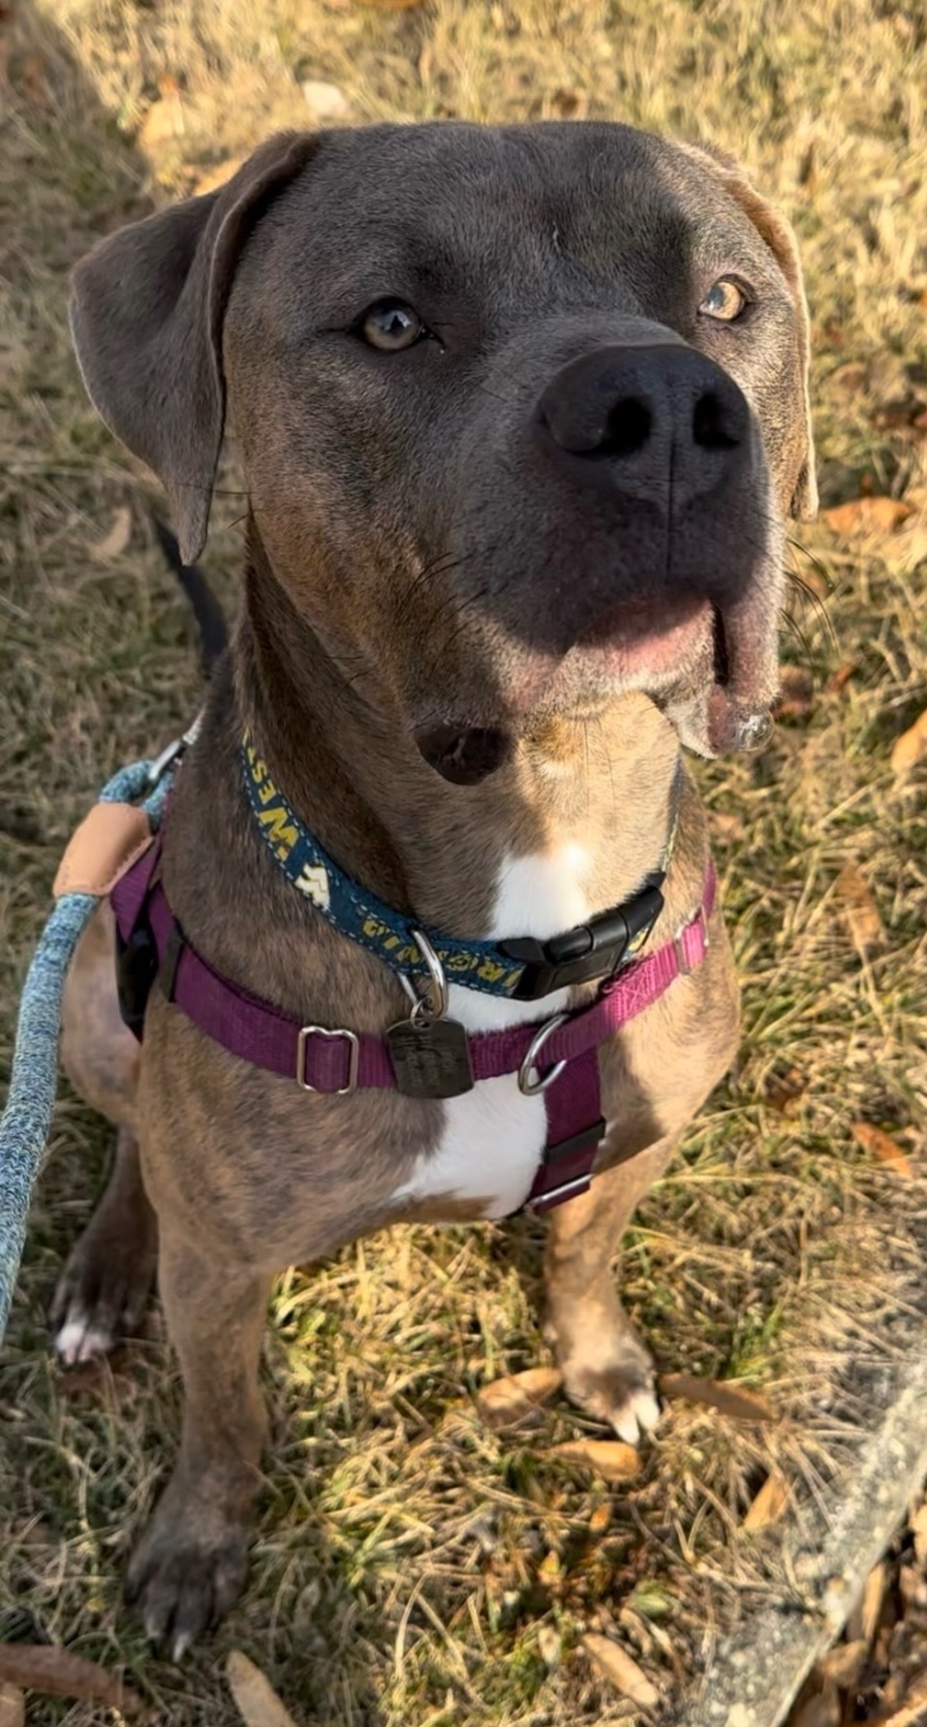
Success Story: Finch
Our experience with the HOME Scholarship through IACS helped us tremendously with our then foster, Finch. In Mid-November 2023, we visited IACS to bring a foster dog home due to the overpopulation IACS was (still is) experiencing. We were matched with Finch, a wonderfully energetic young dog. Already having a larger, older dog in the home, adding another large dog to our small home who had endless energy became a little overwhelming at times. We tried to teach Finch new behaviors as he was over-focusing on our cat, jumping, and a little mouthy. After time going by and being unsuccessful on our own, we decided to take advantage of the HOME Scholarship for help. Allie visited with us, listened to our concerns, and in the same visit began training Finch and educating us. We learned so much about enrichment activities to help Finch keep busy in appropriate ways and to keep his mind active. Allie also worked with Finch on 'touch', which would ultimately help us with over-focusing on our cat as well as redirecting him before he could get too excitable about a distraction. We learned that his mouthiness was normal, and Allie shared activities that would give him an outlet for this behavior. Lastly, instead of acknowledging his jumping with a 'no' or another request, we learned to just ignore the behavior so he doesn't have an incentive to keep doing it. We were blown away by how much we learned in an hour, and having the documentation for reference after the visit was incredibly helpful. We did end up adopting Finch, and Allie's knowledge/experience definitely helped us have a less chaotic home.

Slide 12
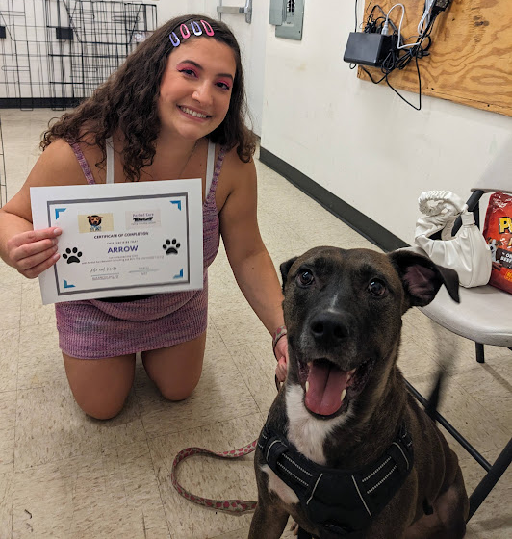
Group Training Classes
Less expensive alternative to private training
Built-in distractions
Live coaching from Instructors
Increased accessibility
Community building: everyone has new dog struggles!
Great option for post-adoptive support
Notes:
Less expensive alternative to private training
More available to more people!
Community-building
Allow adopters to see that they are not alone with new-dog struggles
Built-in distractions for training
Other dogs, new sights and smells
Live coaching from instructors
Great option for shelters to offer adopters
Training is key for post-adoption success

Slide 13
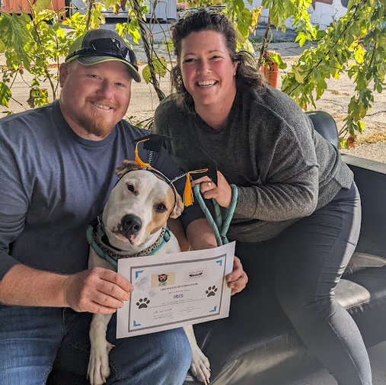
Group Class Structures
Puppy Classes
Socialization focused
Problem Prevention
Impulse-Control Classes
Aimed at adolescents
Highest-risk group for relinquishment
Opportunity to involve volunteers and currently sheltered dogs:
Increase adoption opportunities!
Notes:
Puppy classes
Socialization focused
All about problem PREVENTION
Impulse control classes
Aimed at adolescent dogs
Highest risk group for relinquishment to the shelter for behavior reasons
Opportunities for involving volunteers and dogs currently in the shelter
Dogs with training skills are more likely to be adopted

Slide 14
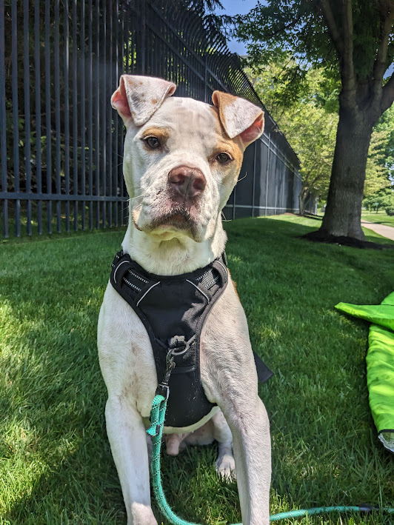
Why Does This Matter?
Reduce Community Biases
Capacity Crisis
~10% of adopted pets are returned
107,000 additional dogs were in shelter at the end of 2023 compared to 2022
25% of dogs are relinquished by owner
Education and Outreach Opportunities
Increase community support and familiarity
*based on 2023 data from the Shelter Animals Count national database
Notes:
Capacity crisis
~10% of adopted pets are returned*
107,000 additional dogs in shelter at the end of 2023 compared to 2022*
25% of dogs are relinquished by owner*
Community biases
Education and outreach
Increase support and familiarity
Shelters as a community gathering point, not a sad place
Training is fun!

Slide 15
Welfare-Focused Education and Training Saves Lives
Keeps dogs out of shelters and in homes
Promotes healthy and empathetic relationships with companion animals
Decreases presentation of fearful and aggressive behaviors
Notes:
Welfare-focused dog training methods and education save lives by:
Keeping dogs out of the shelter and in homes
Promoting healthy and empathetic relationships with dogs
Decreasing presentation of fearful and aggressive behaviors

